Slide 1

Energy and Industial Plants
Consultancy & Project Management

Slide 2

About KLE Engineering:
KLE Engineering is a leading engineering and contracting company operating both in international and local markets including Mechanical, Electrical and Instrumentation Erection works from detailed engineering to procurement, fabrication and installation of project materials.
Managing Staff of KLE Engineering has taken role for the accomplishment of major Mechanical and electrical projects by using his dynamic team and international experience, latest information and technology in engineering & management sciences.
KLE managing staff always ensures the highest quality & standards based on international acknowledged procedures.

Slide 3
The main operation objective of KLE Engineering is to undertake and realize challenging projects including all disciplines such as;
  Consultancy
  Design
  Project Management
  Contract / Claim Management
  Fabrication & Installation
  Procurement Process
  by targeting completion of the project scopes;
Main Targets:
On time – within budget – by required quality – zero loss time injury rate

Slide 4
Main Fields of Activities :
Power Plants
Combined Cycle and Cogeneration Plants
Gas Turbines
Thermal Power Plants
Solar Power Plants
Wind Power Plants
Diesel Power Plants
Industrial Plants
Iron & Steel Plants
Cement Plants
Food, Beverage, and Medicine Plants
Steel Structure Fabrication & Erection
Structural Steel for Industrial Buildings
Platforms, Decks, Towers, etc.
Storage tanks, steels,
Secondary steel structure
Process Plants
Petroleum Refineries
Petrochemical Plants
Fertilizer Plants
Marine Works
Seawater intake/outfall systems
Jetty and platforms
Piling Works
Pump Stations
E&I / Power Distribution Facilities
Transformers & Substations
Switchyards
Cables, terminations
Instrumentation & Hook-up & Calibration
Grounding, Lighting & Lightning
Electrical Heat Tracing
Telecommunication Systems
Environment
Water Treatment Plants
Flue Gas Treatment Plants
Waste Water Treatment Plants
Pipe Spool Fabrication & Installation inc. NDT works
Carbon Steel Pipe Spools
Alloy Steel Pipe Spools
Stainless Steel
Duplex Pipes
GRP & HDPE Pipe Installation

Slide 5
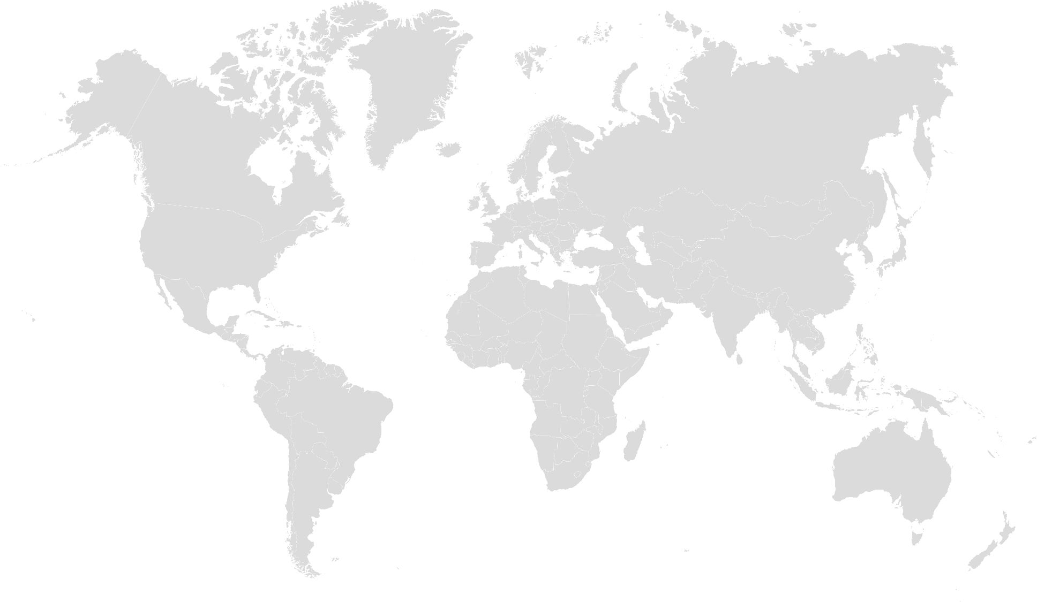
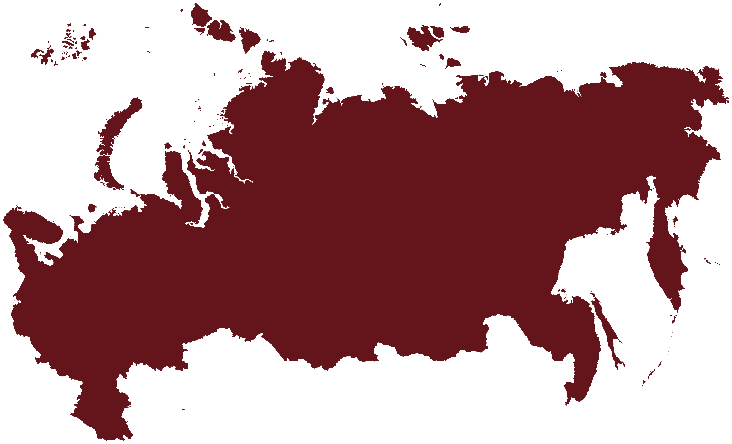


Main Projects completed by Managing Staff
Turkey
Russia
Albania
Turkmenistan
Azerbaijan

Slide 6
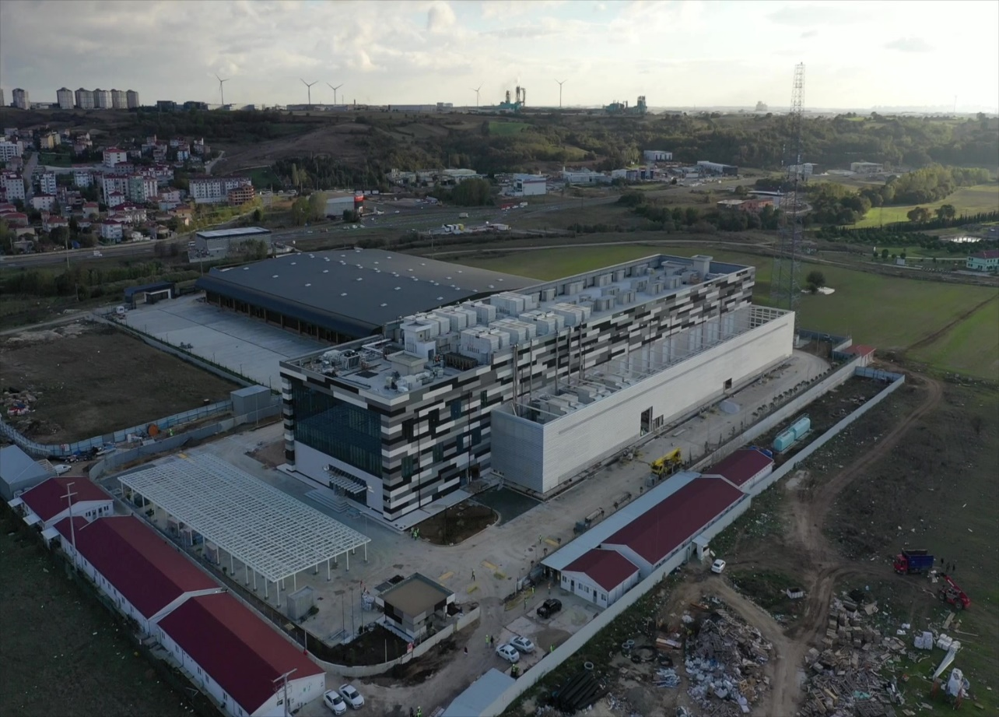
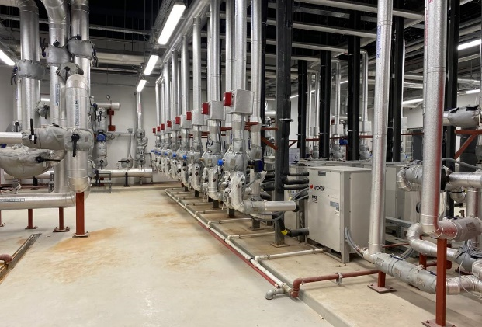
TURKCELL – EUROPE DATA CENTER
ÇORLU, TURKEY
Owner : TURKCELL
Main Contractor : SERBAN İNŞAAT A.Ş.
Start Date : March 2019
Date of Comp. : December 2020
Description of work :
The Project located in ÇORLU - TURKEY
43.000 sqm project area, 6.800 sqm w, TIER 3 Certified, LEED GOLD Green Building Certified
Services Provided: Project management - Consultancy

Slide 7
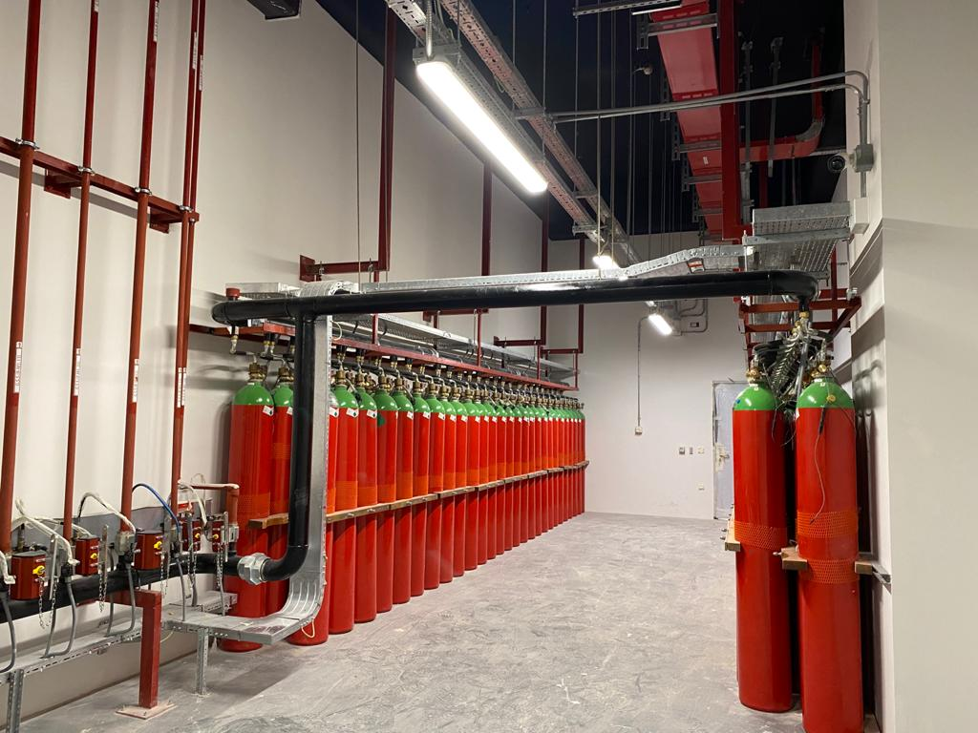
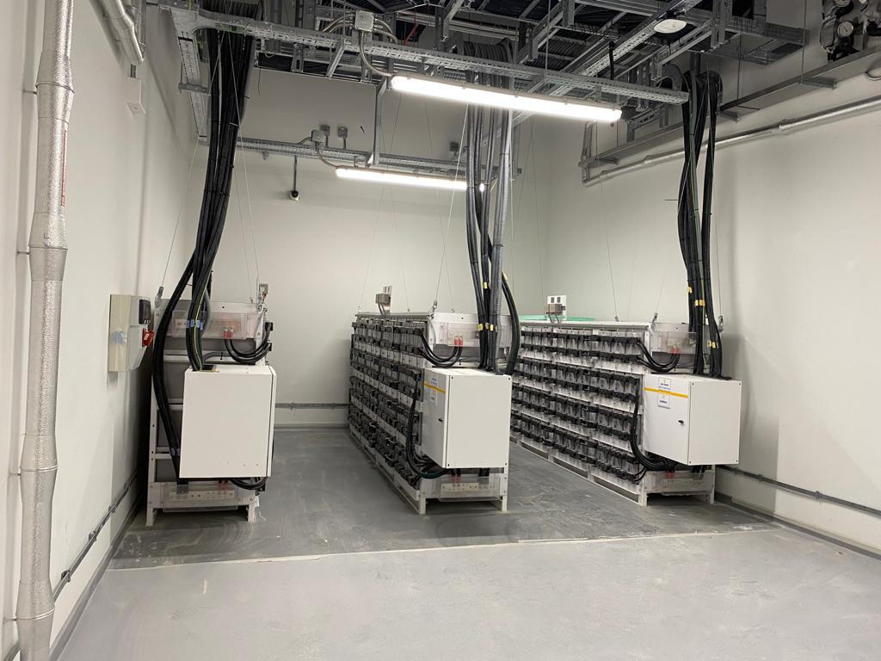
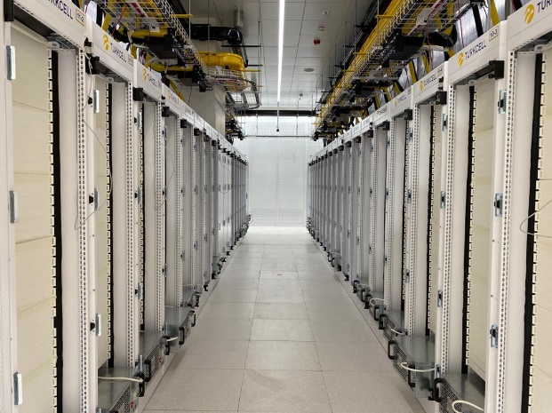
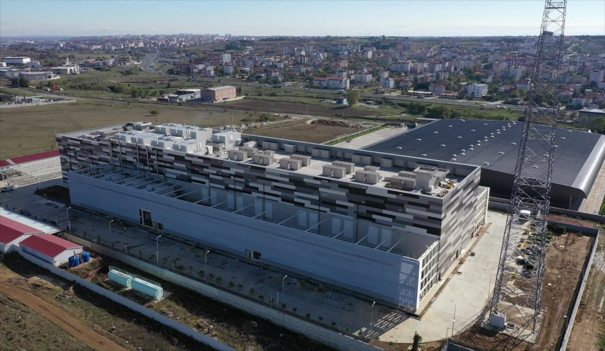
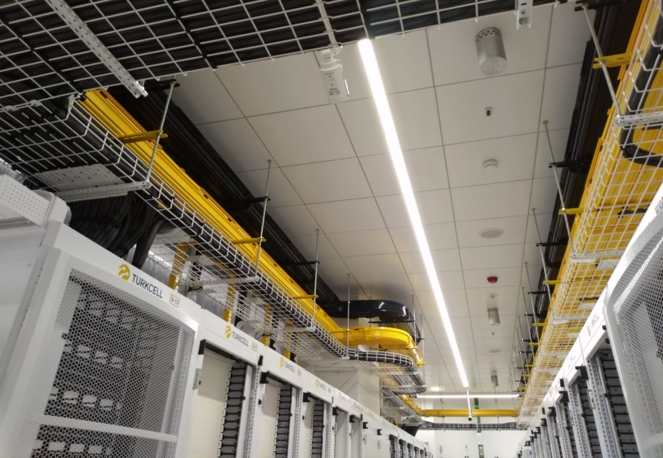

Slide 8
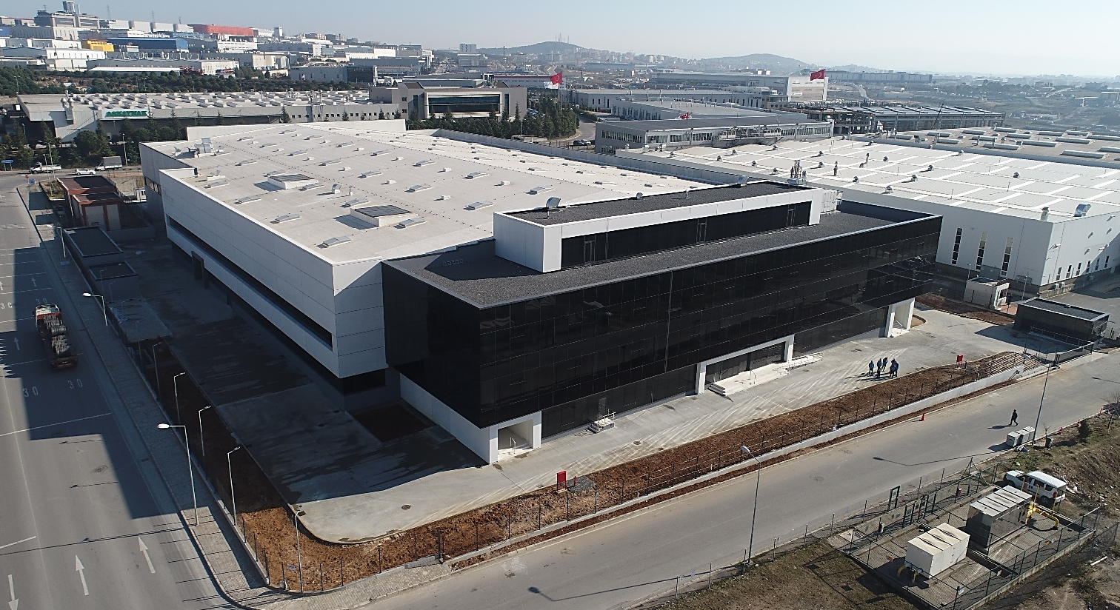
IMPRO – CENGIZ MAKINA
GEBZE, TURKEY
Owner : IMPRO Cengiz Makina
Main Contractor : Tekyol Plus
Designer : SEZA Eng.
Date of Comp. : May 2 2018
Description of work:
  Project managemet and consultancy including desing, procurement, installation, commissioning.
  Contract management, claim management.
  Total : 20.000 sqm

Slide 9
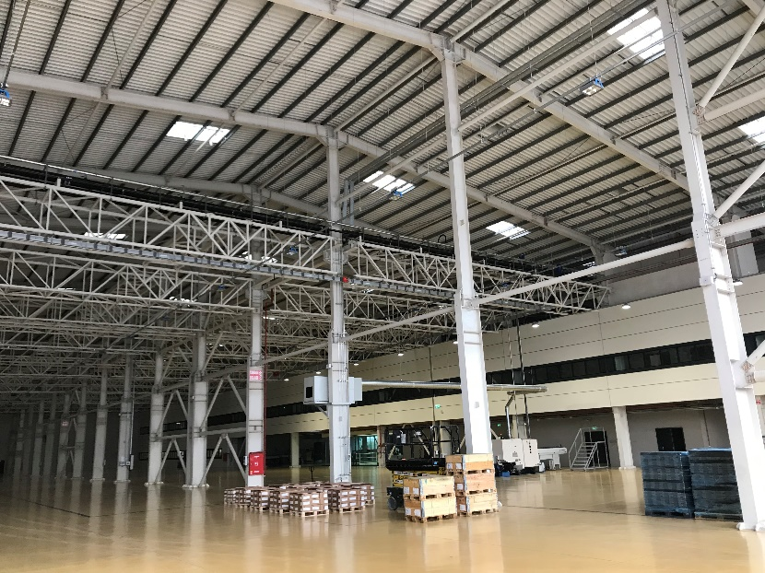
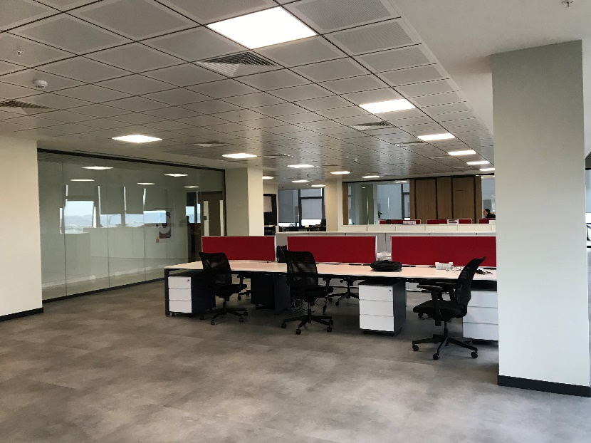
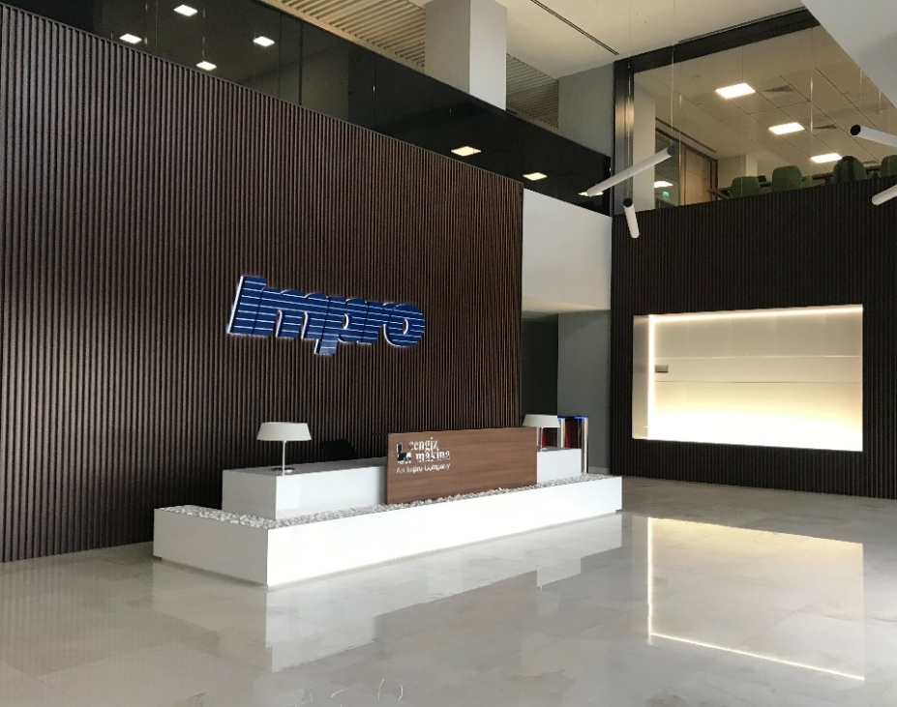
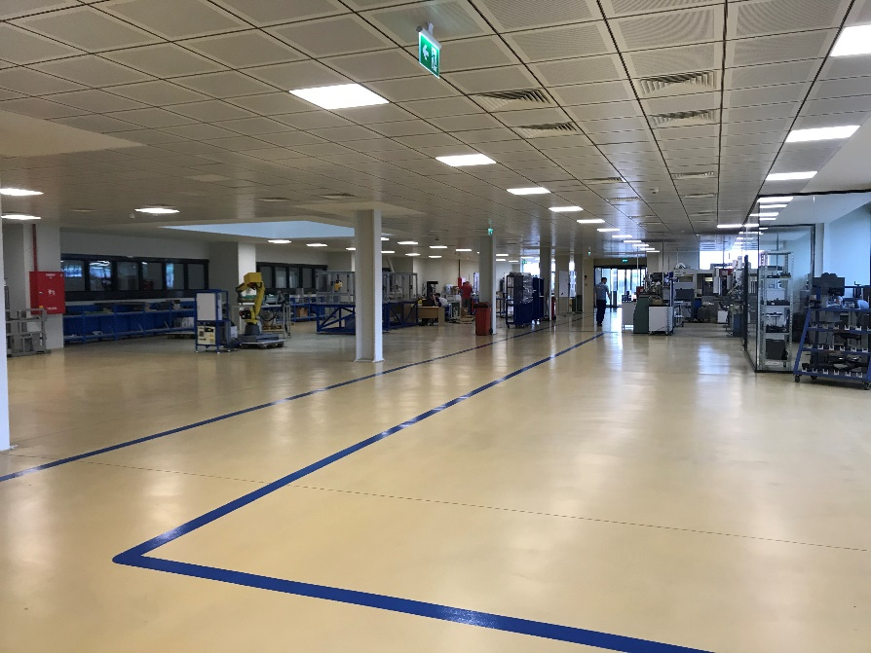
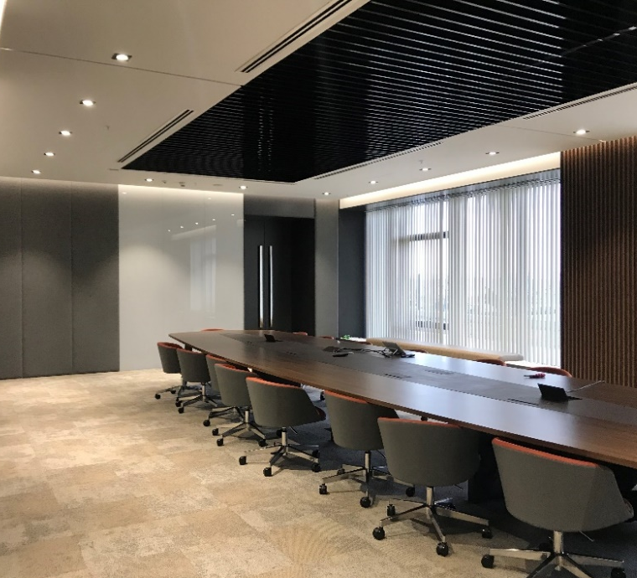

Slide 10
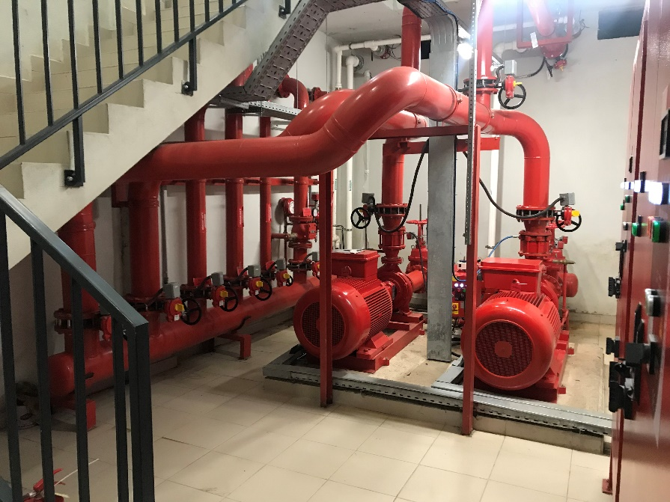
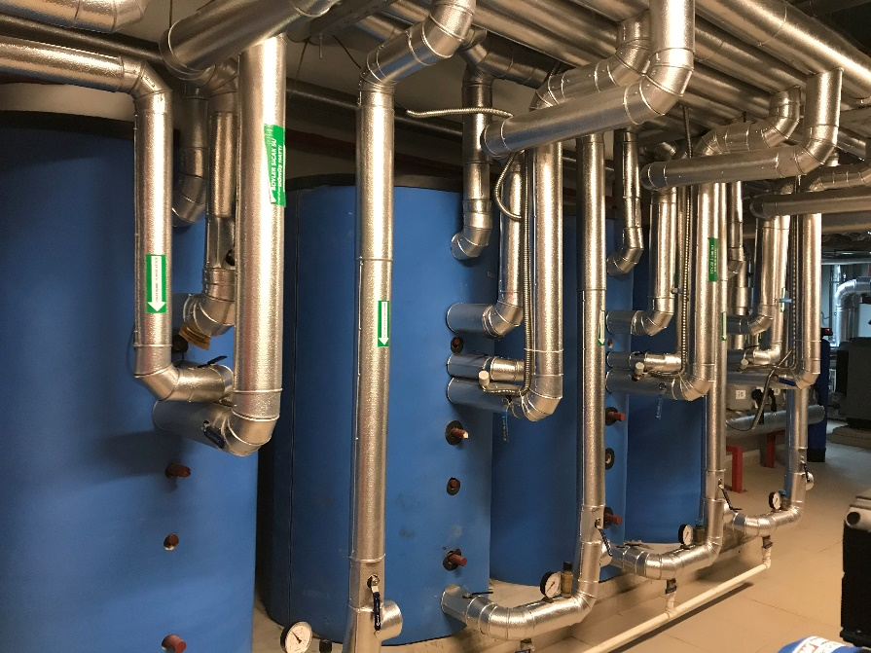
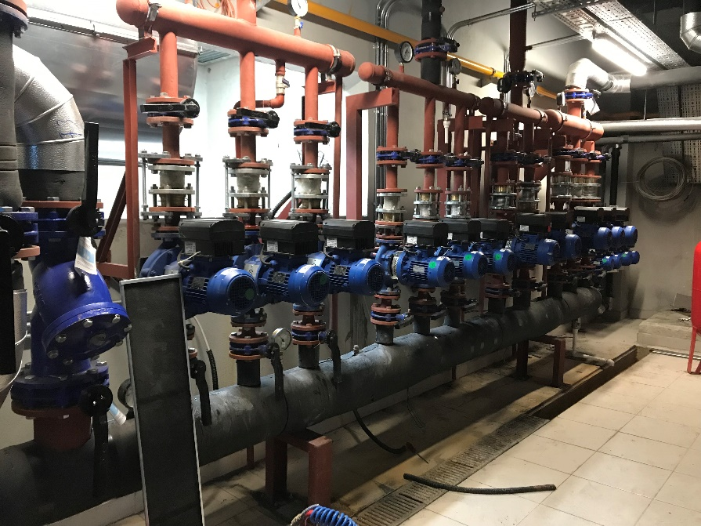
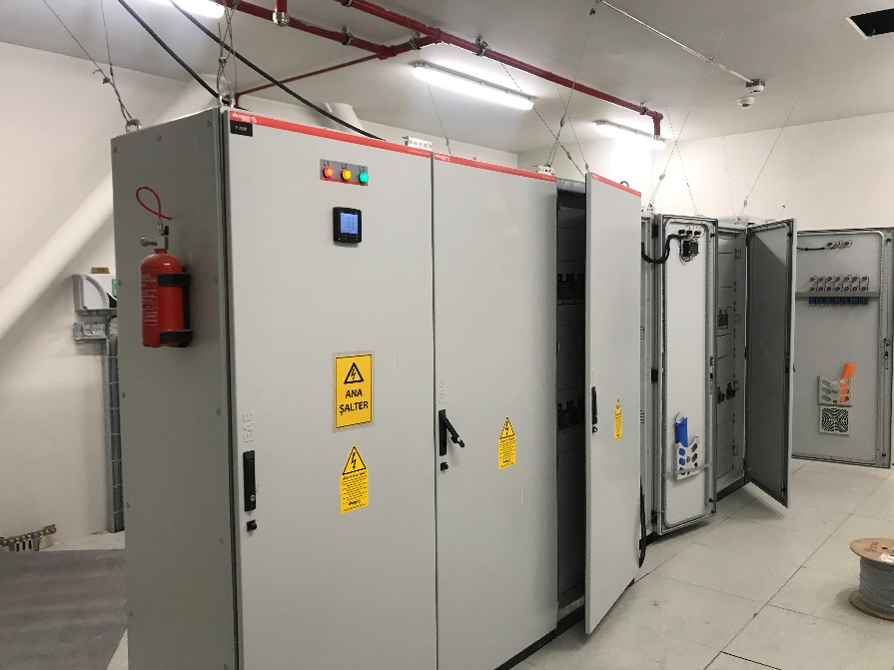

Slide 11
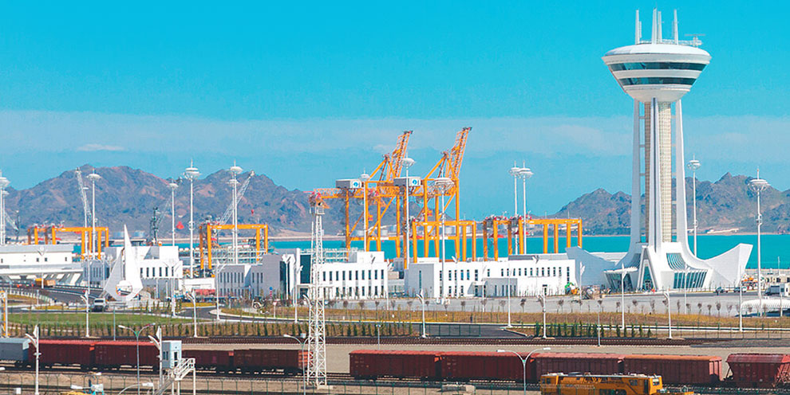
International Türkmenbaşı Seaport Project
Turkmenbası, Turkmenistan
Owner : The State Service of Maritime & River Transportation of Turkmenistan
Main Contractor : Gap İnşaat
Designer : 2ER Consulting
Date of Comp. : May 2 2018
Description of work:
  The project “Türkmenbaşı Seaport” scope is not only importent for the EPC scope of below mentioned terminals
  Ferry and passenger terminal,
  Container terminal,
  General cargo port
  Bulk cargo port
  Ship building and repair facility are built
  Ro-Ro and polypropylene terminal is expanded.
  But also, by the budget of $1.5 billion is constructed as the biggest seaport of the Caspian Sea

Slide 12
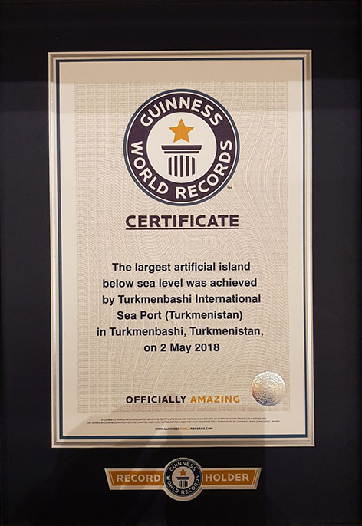
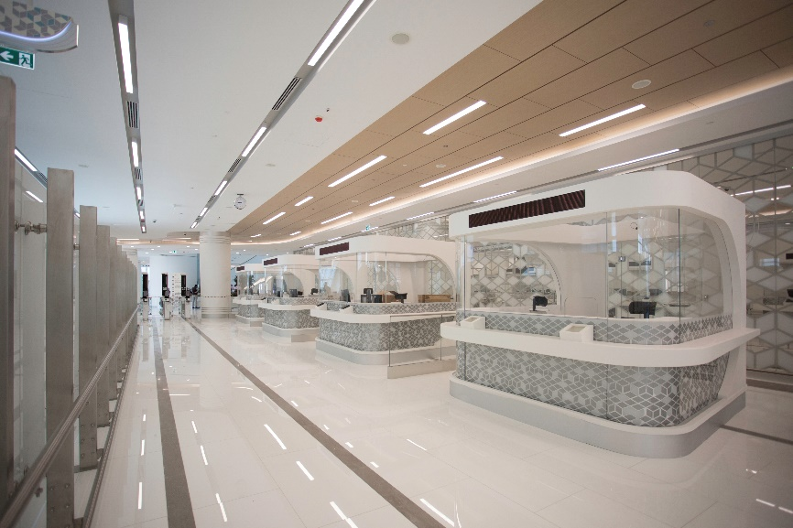
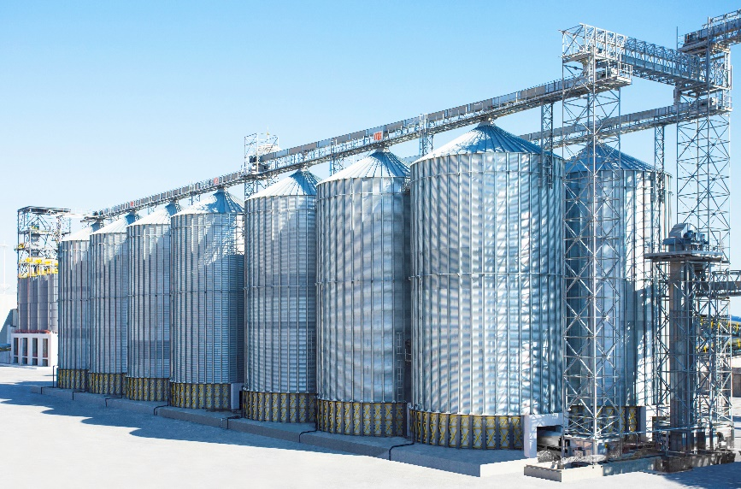
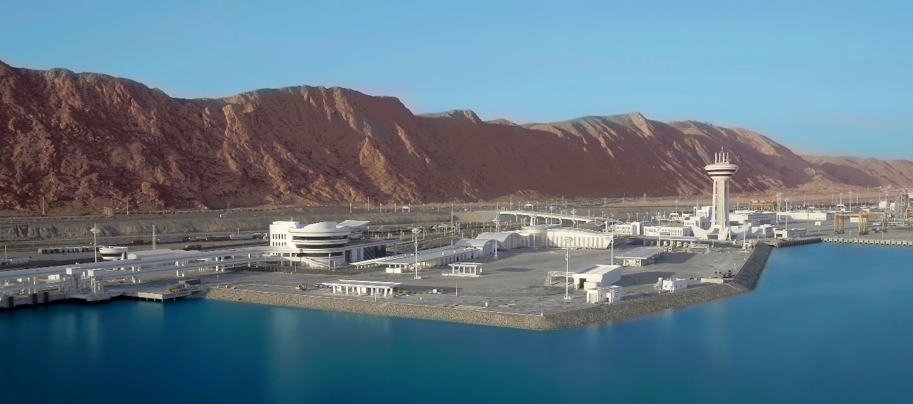
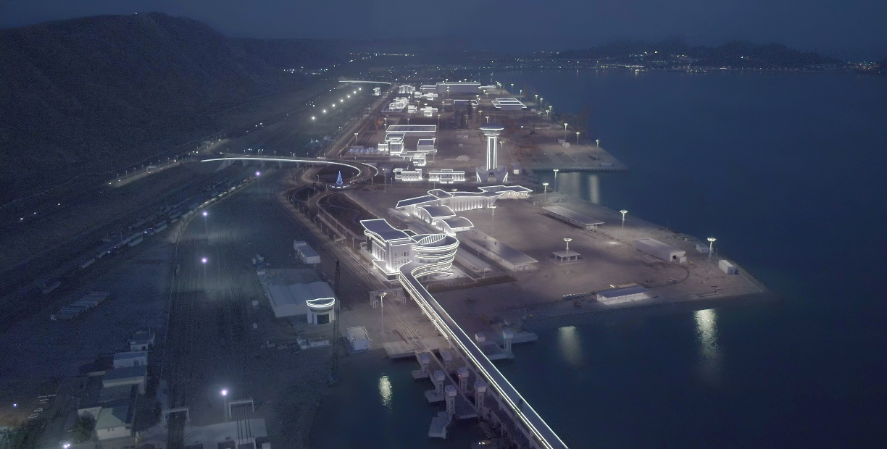

Slide 13
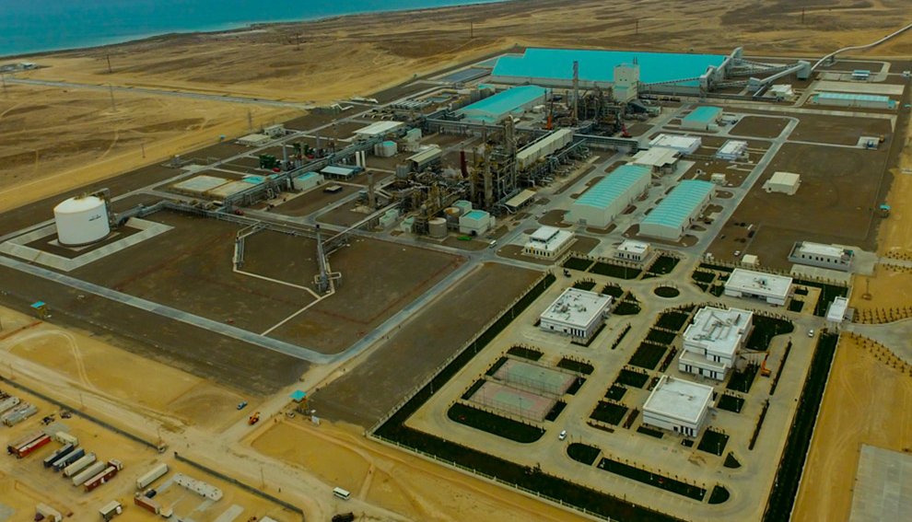
Garabogaz Ammonia and Urea Production
Garabogaz, Turkmenistan
Owner : Turkmenistan Ministry of Chemistry
Main Contractor : Gap İnşaat / Mitsubishi Corporation
Subcontractor : Mitsubishi Heavy Industries
Date of Comp. : June 30, 2018
Description of work:
Annual production capacity of 1.155.000 tons
Budget of $1.35 billion,
The biggest ammonia & urea production
plant of Turkmenistan

Slide 14
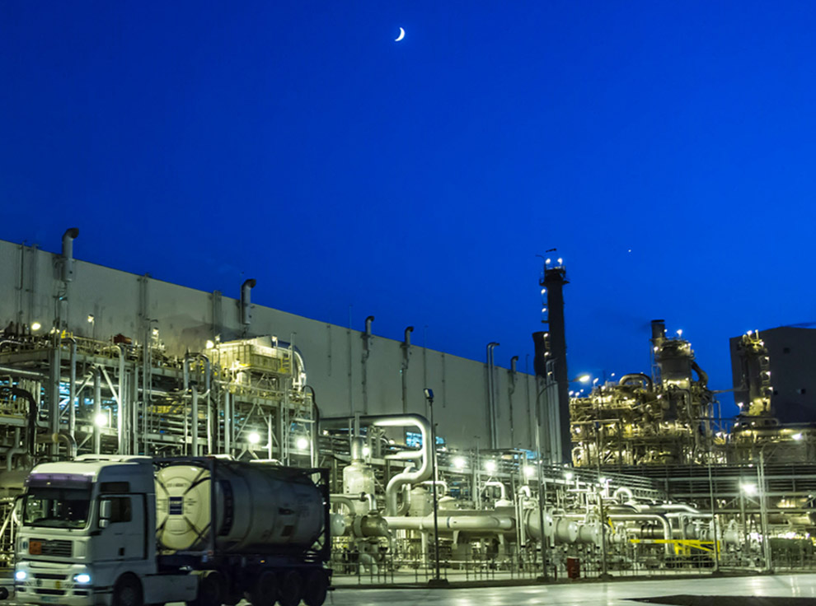
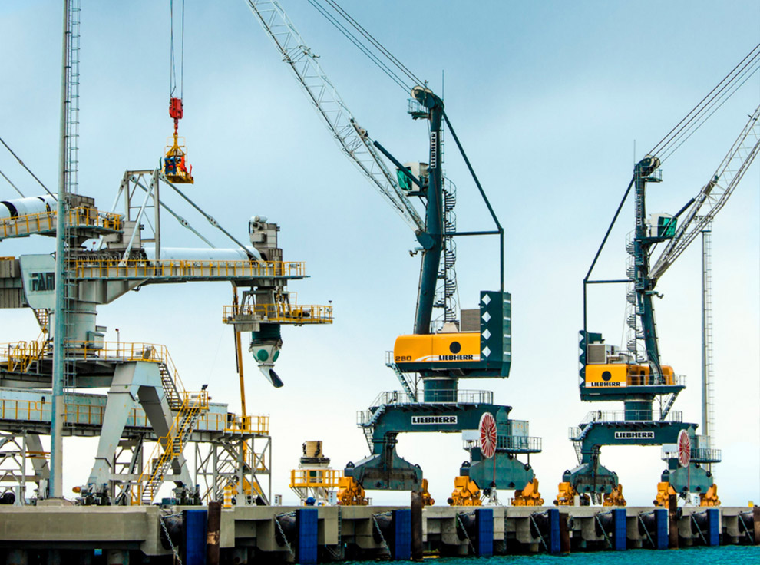
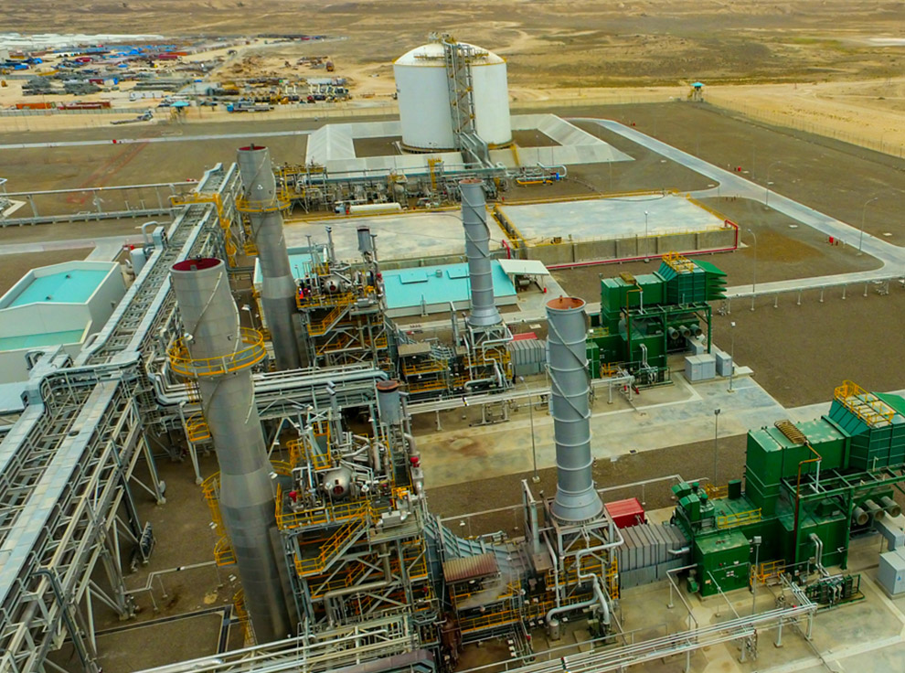
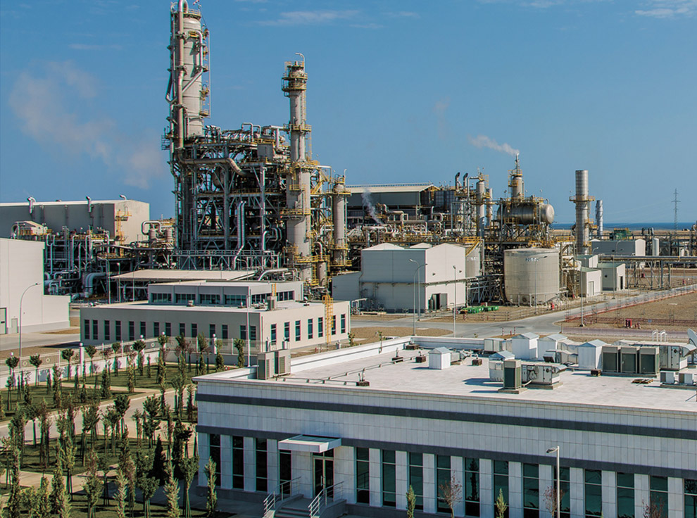

Slide 15
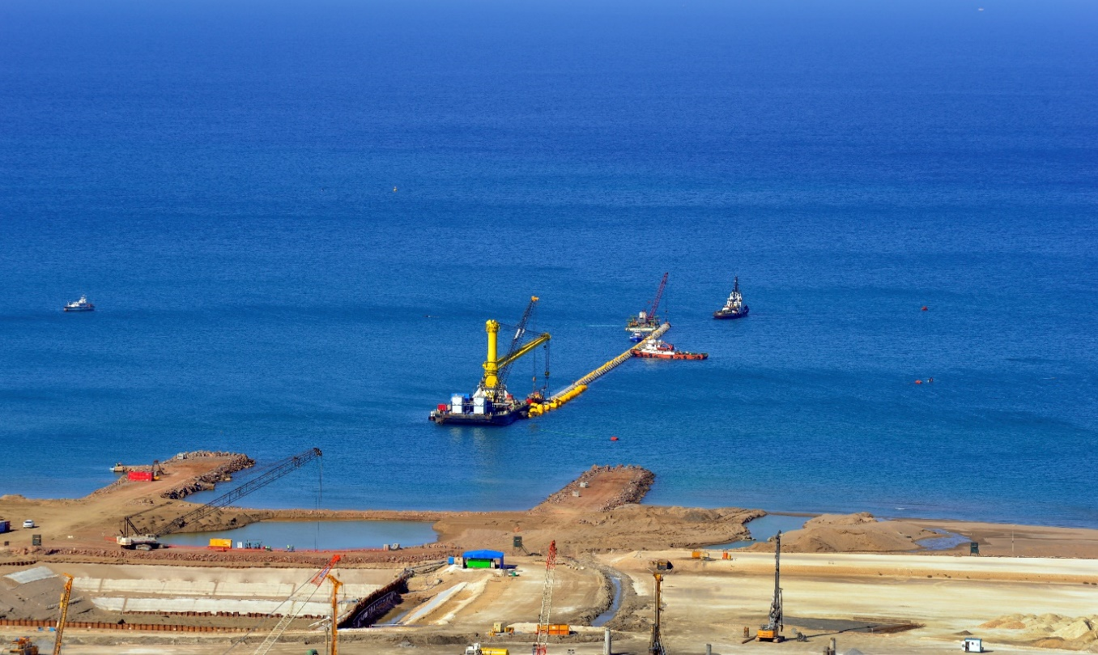
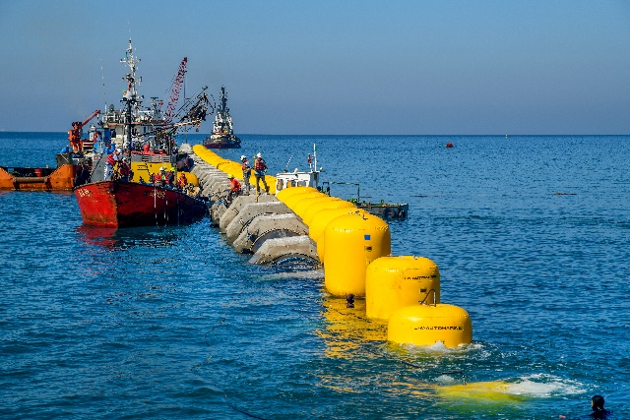
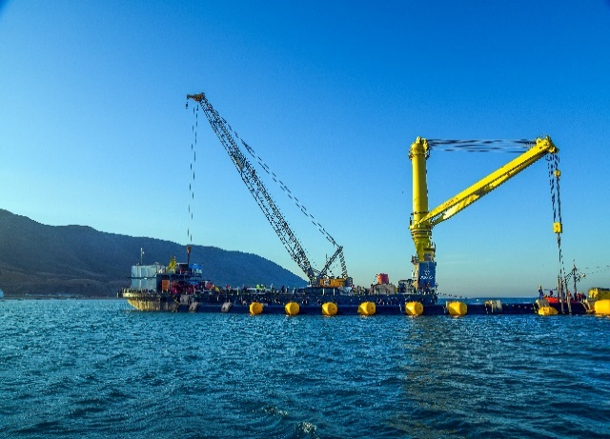
1450 MW Mostaganem PP Cooling Water Intake System / ALGERIA
Owner : SONELGAZ - ALGERIA
Key Designer : SAMSUNG SC&T
Contractor : TML İNŞAAT A.Ş.
Start Date : May – 2017
Description of work : The Scope of Project is installation of Cooling Water Intake Pipeline
( 5 ea x 2000 mt. , HDPE Pipes with 2500 mm diameter ) including precast concrete ıntake head structures as well as discharge unit for 1450 MW Combined Cycle Power Plant Project at MOSTAGANEM - ALGERIA

Slide 16
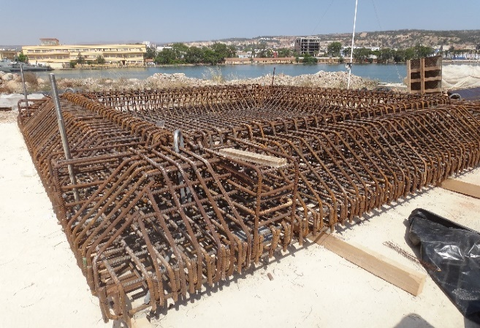
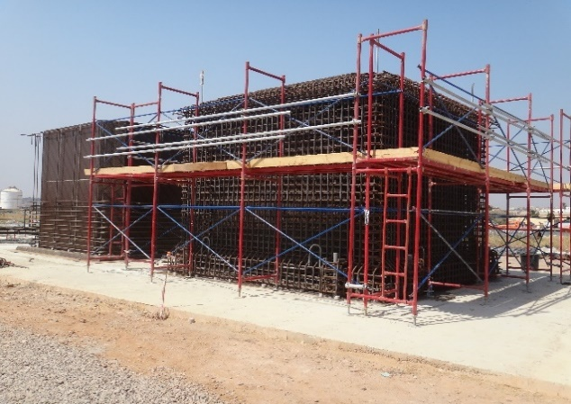
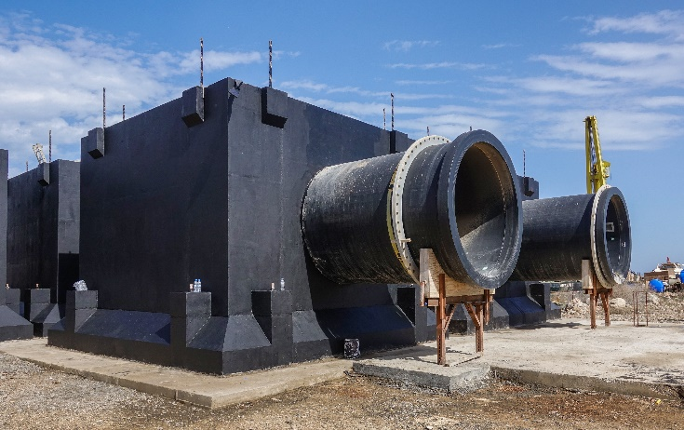
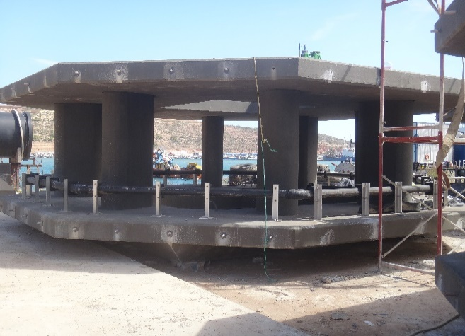
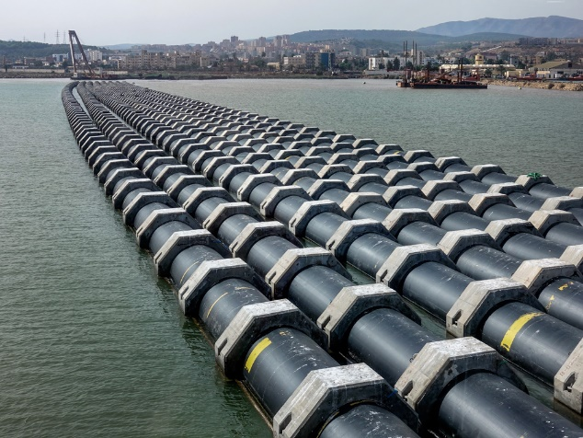
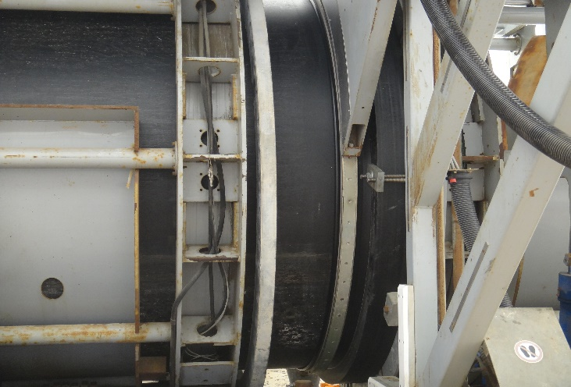
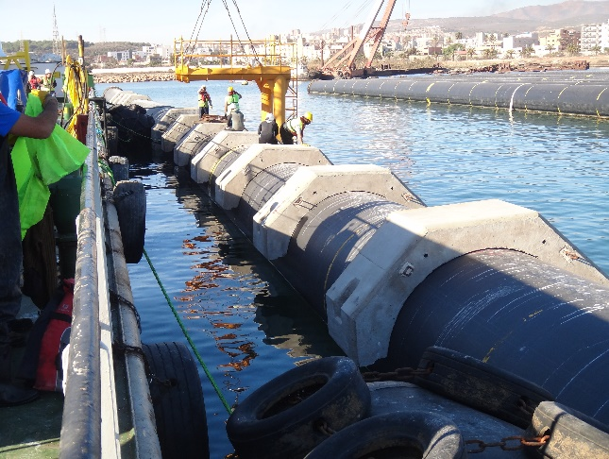
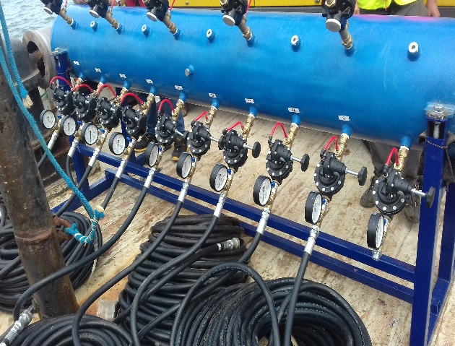
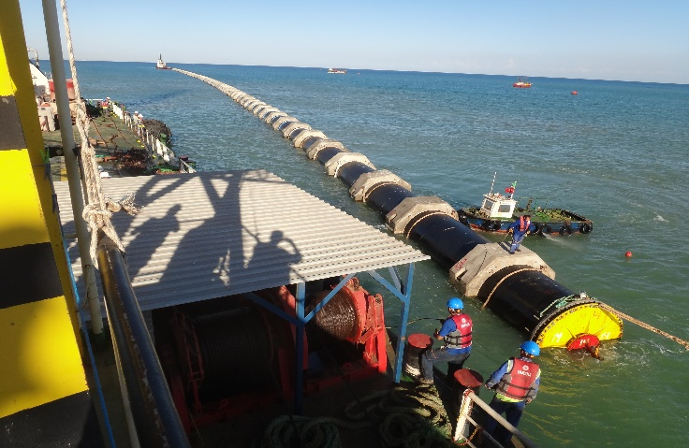

Slide 17
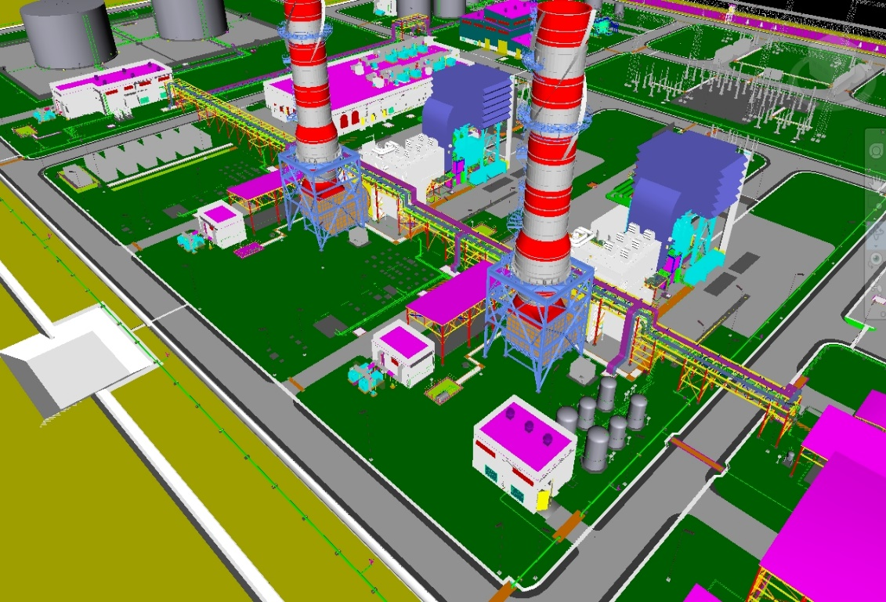
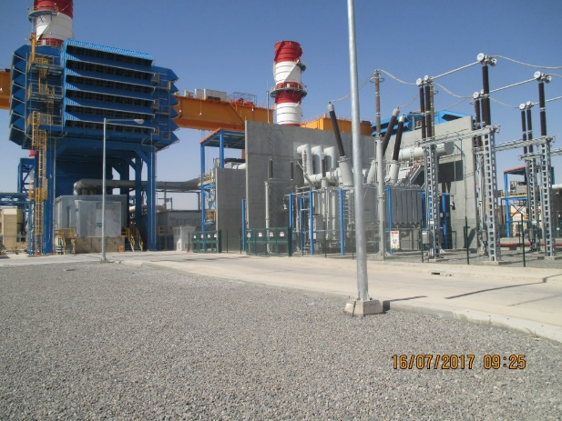
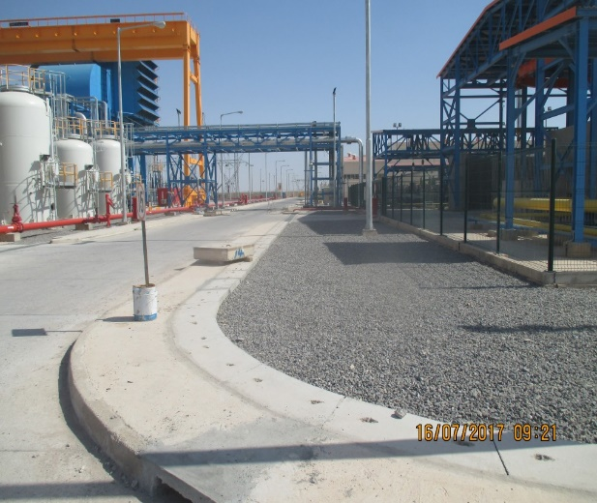
BISKRA 230 MW SCPP PROJECT
ALGERIA
Owner : SONELGAZ – ALGERIA SONELGAZ ( National Society for Electricity and Gas ) - ALGERIA
Main Contractor : HANWHA ENGINEERING & CONSTRUCTION Corp.,
Subcontractor : YOUKAIS BETATEK E & C SPA
Start Date : September - 2015
Date of Completion : June – 2017
Description of work : Complete Electrical, Mechanical and Instrumentation Installation Works of 230 MW Gas Turbine PP

Slide 18
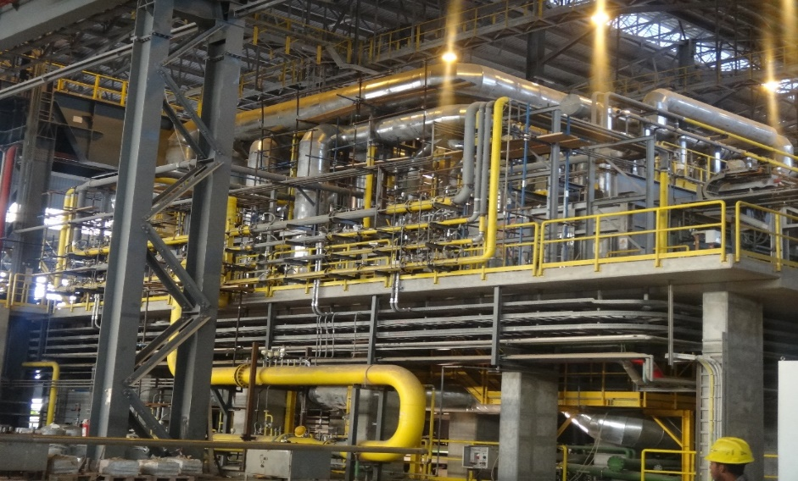
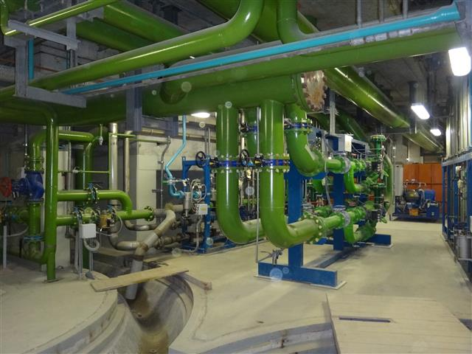
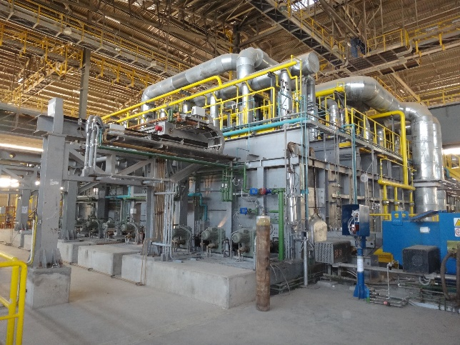
0,8 mtpy New Bar Rolling Mill Project
LIBYA
Owner : LISCO – LIBYAN IRON AND STEEL COMPANY
Main Contractor : TML INŞAAT A.Ş.
Engineering & Suppy : DANIELI - ITALY
Consultant : DASTUR
Start Date : January - 2012
Date of Completion : September – 2016
Description of work : The project located in Misurata – LIBYA , Mainly consist of two part
- Reconditioning of the existing Facilities
- Balance Erection Works of 0,8 mtpy New Bar Rolling Mill Facility
( Mechanical , Electrical & Instrumentation Erection Works & Piping
including Cold Tests and Commissionig assistance Works.)

Slide 19
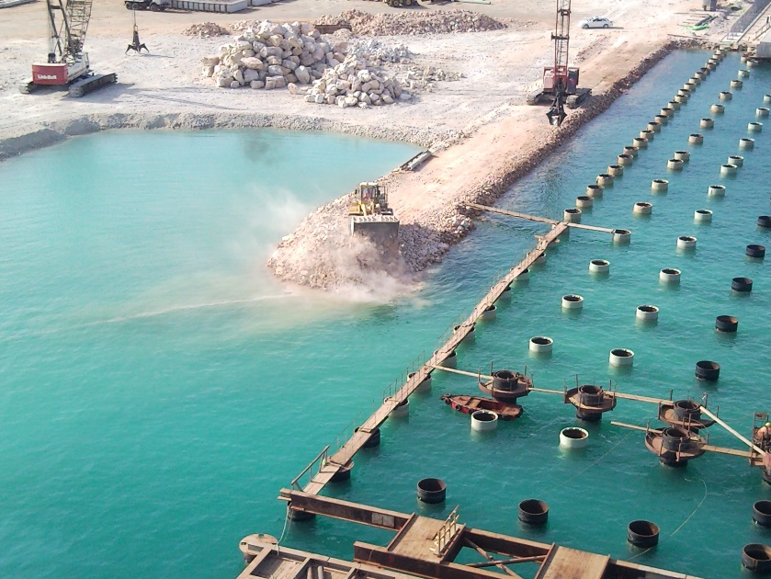
Construction of Container Terminal Project
LIBYA
Owner : Misurata Free Zone Administration
Main Contractor : TML INŞAAT A.Ş.
Key Designer : Optimum Engineering
Start Date : July - 2009
Date of Completion : May – 2014
Description of work : Construction of berths for the berthing up to 81.000 DWT Container Vessels.
The Deck Structure; steel pipe pile foundadtions supporting a combined precast and in-situ concrete structure.
The total length of the berth is : 800 mt.
The Works performed for the construction of the berths as follows :
- Fabrication of two Jack-up barges ( 400 ton capacity each ) including detailed design.
- Construction of 589 mt. Long berths with 696 pcs of piles, each 48 ‘’ diameter with 20 mm thickness and min 36 mt. in length , supporting a combined precast and in-situ concrete deck structure.
- Extention of 211 mt. Long existing berths with 102 pcs of piles on the sea side each 48 ‘’ diameter with 20 mm thickness and min. 36 mt. in length süpporting a combined precast and inüsitu concrete deck structure and 54 pcs of bored piles on the Land side each 1.000 mm diameter and 15 mt. in length supporting SSG Crane Beams.
- Supplying and Installation of rubber fenders.
- Applying Catodic Protection to all exposed ferrous members includ. Steel Piles
- Supplying and Installation of Crane Rails

Slide 20
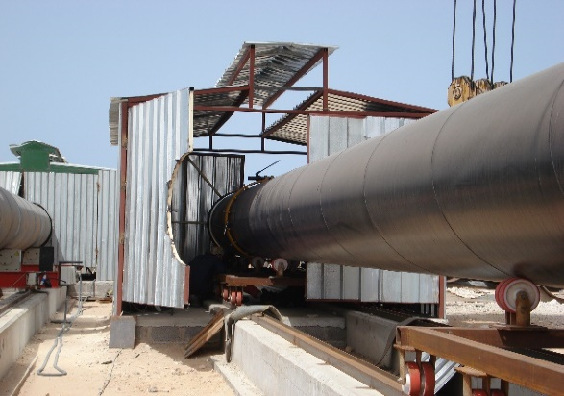




Slide 21



Baku Shipyard Project
AZERBAIJAN
Owner : BAKU SHIPYARD LLC
Consultant : ROYAL HASKONING
Main Contractor : SOCAR NEFTGASZ TIKINTI
Key Designer : ENCOTEC
Start Date : February - 2017
Date of Completion : September – 2013
Description of work : Construction of 4 building in Baku Shipyard Project
Total Area is : 44.000 m2 . Two Steel Structure Building ( 28.200 m2 ) and three reinforced concrete building ( 15.800 m2 )
The Total Weight of Fabricated and Installed Steel Structure is : 6.500 Ton includ. Detailed Design and Shop drawings.

Slide 22



Karbela 300 MW Power Plant
IRAQ
Owner : Ministry of Electricity - IRAQ
Main Contractor : STX Construction Co. Ltd.
Subcontractor : BETA Engineering and Erecion Inc.
Start Date : October - 2011
Date of Completion : June – 2012
Description of work : Turnkey Construction of 300 MW Diesel Power Plant Including
all Civil, Mechanical, Electrical & Infrastructural Works.

Slide 23



Diwaniyah 200 MW Power Plant
IRAQ
Owner : Ministry of Electricity - IRAQ
Main Contractor : STX Construction Co. Ltd.
Subcontractor : BETA Engineering and Erecion Inc.
Start Date : November - 2011
Date of Completion : July – 2012
Description of work : Turnkey Construction of 200 MW Diesel Power Plant including
all Civil , Mechanical , Electrial & Infrastructural Works.

Slide 24

VLORE 1x100 MW CCPP
Vlore, ALBANIA
Owner : KESH Albanian Power Corporation
Main Contractor: MAIRE TECNIMONT S.p.A
Subcontractor: SOEPRO J.V. (EPRO Power and Industrial Plants Inc. – SOECO Engineering and Construction)
Date of Completion: September 2009
Description of work: Complete Mechanical Erection , Piping, Insulation and Painting Works of 100 MW Single-Shaft Combined
  - Cycle Power Plant.
  - Gas Turbine, Steam Turbine, Generator and auxiliaries (Supplied by Ansaldo-Italy)
  - HRSG (Supplied by Nooter Ericsen – Italy)
  - Condenser (Supplied by Ofmeco– Italy)
  - Piping and Supports (Fabrication, Erection, PWHT, NDT, Painting ,Insulation, Testing)
  - BOP Equipments and Systems i.e. Water Treatment Plant, Sea Water Pumps, Fuel Oil Storage, etc
  - 4300 m. API 5L Fuel Oil Piping for Offshore connection between CBMS and Site (Welding and NDE testing)

Slide 25




Slide 26

Sumgait 500 MW CCPP
AZERBAIJAN
Owner: AZERENERJI JSC.
Main Contractor: SIEMENS AG. Power Generation
Subcontractor: CMI Energy HRS – EPRO Power & Industrial Plants Inc. Consortium
Date of Contract: August 2005
Date of Completion: May 2007
Description of work:
- Engineering, Supply, Manufacturing, Erection and Commissioning of 2 Heat Recovery Steam Generators

Slide 27





Slide 28

AKENERJİ CCPP
İzmir, TURKEY
Owner: Akenerji
Main Contractor: General Electric Energy Products Europe
HRSG Contractor: NEM BV, The Netherlands
Subcontractor: EPRO Power and Industrial Plants Inc.
Contract Date: 22 .01.2004
Date of Completion: December 2004
Description of work:
  - Complete Mechanical and Instrument Erection Works of 2 Heat Recovery Steam Generators and associated equipment
  - 32 Tons piping including supports and valves
  - Instrument Installation
  - Supply and installation of Insulation
  - NDT, PWHT services

Slide 29


Karadagh GCSP
AZERBAIJAN
Owner: Joint Stock Company AZERGAZ
Main Contractor: Toyo Engineering Corp.
Civil and M/E/I Erection: TML – BOROVA - EPRO
Date of Completion: August 2003
Description of Work:
  - Complete Mechanical / Electrical / Control & Instrumentation Erection Works of Gas Compressor Station also including
  - Supply of all structural steelwork for compressor building and pipe racks
  - Design, supply and fabrication of fire works storage tank
  - Supply and fabrication of vent stack

Slide 30





Slide 31



Severnaya 400 MW CCPP
Shuvelan, AZERBAIJAN
Owner: Joint Stock Company AZERENERJI
Consultant: Burns and Roe Enterprises, Inc.
EPC Main Contractor: Mitsui & Co. Ltd.
Sub-Contractors: Mitsubishi Heavy ınd. - ABB - EPRO
Date of Start / Completion: M/E/I Works August 1, 2001 / November 15, 2002
Description of work:
- Complete Mechanical / Electrical / Control & Instrumentation Erection Works of 400.MW Single-Shaft
- Combined Cycle Power Plant including Structural Steel works of GT Building / Pump House and Underground
- CW Pipeline.

Slide 32
Major Equipment Erection:
  Gas Turbine & Auxiliries: 710ton
  Steam Turbine & Auxiliaries: 960ton
  Main Transformer: 270ton
  Gas Compressor: 110ton
  Water Treatment Plant: 100ton
  Start – Up Boiler: 175ton
  Others: 800ton
  Total: 3125ton
  Piping:
  Cooling Water Pipes: 2500ton
  Power House&Off-Sites: 1200ton
  Total: 3700ton
  HRSG:
  Steel Structure: 480ton
  Modules: 1666ton
  Drums & BDT: 136ton
  Casing, Ducting & Stack: 211ton
  Piping: 230ton
  Insulation: 75ton
  Others: 50ton
  Total: 2848ton
  Storage Tanks:
  Total: 506ton
  Electrical & Instrumentation:
  Power & Lighting Cables: 118km
  Control & Instrument. Cables: 213km
  Switchgears, UPS, Batteries
  Control System, Instruments
  Steel Structure:
  Turbine-Gen. Building: 1200ton
  Others: 445ton
  Total: 506ton

Slide 33





Slide 34


Eskişehir Industrial Power CCPP
Eskişehir OSB ,TURKEY
Owner: Eskişehir Industrial Power Generation Autoproductor Group Co.
Supplier of Main Equipment: BABCOCK & WILCOX ESPANOLA S.A
Contractor: EPRO Power and Industrial Plants Inc.
Date of Completion: April 2001
Description of work:
  Complete Mechanical and Instrumentation Erection Works of a Heat Recovery Steam generator and associated equipment.
  523 tons Mechanical Equipment.
  17 tons Piping including supports and valves.
  Complete Instrument Installation works including supply of cables, cable trays,Conduits and junction boxes.
  Complete Inspection and Test. (i.e. NDT, PWHT, HT, Blow-out)

Slide 35

TÜPRAŞ CCR & ISOMERIZATION PLANT PROJECT
Aliağa, İZMİR, TURKEY
Owner : TÜPRAŞ,Turkish Petroleum Refineries Corp. İzmir Refinery
Consultant : Foster Wheeler Italiana
Main Contractor : GAMA Industrial Plants Manufacturing and Erection Corp.
Subcontractor : EPRO Power and Industrial Plants Inc.
Date of Completion : September 2000
Description of work :
  - CCR & Isomerization Plant project, Spool Fabrication &
  Erection works of Underground and Aboveground Pipe Lines including;
  - 645 tons On site Aboveground Piping Erection
  - 285 tons Off site Aboveground Piping Erection
  - 215 tons On site Underground Piping fabrication and Erection
  - 100 tons Pipe Support Fabrication and Erection

Slide 36

TOMSKNEFT GCS
Leuginetskoye, Western Siberia, RUSSIAN
Owner : OAO TOMSKNEFT VNC
Main Contractor : Bateman International B.V, GAMA Industrial Plants Manufacturing & Erection Corp.
Subcontractor : EPRO Power and Industrial Plants Inc.
Date of Completion : November 1998
Description of work : Complete Electrical and Instrumentation Installation Works of Main Compressor Station and Booster Compressor Station including;
- 6 no. Power Transformers and Diesel Generators.
  - 134 no. MV,LV Switchgears and MCC’s and HT panels.
  - 1315 no. Lighting Fixtures including Poles, Supports and Accessories.
  - 262 km. Power & Control and Instrument Cables including Terminations.
  - 22 km. Heat Tracing Cables and complete HT Systems.
  - 25 km. Cable Ladders, Trays and Conduits.
  - 3120 no. Field Instruments including Calibration and Loop Checks.
  - 8 km. Instrument Impulse Piping & 30 no. Instrument Panels (DCS & ESD Systems).
  - UPS, Power Metering and Monitoring Systems, Complete Lightning Protection & Grounding Systems.
  - Fire & Gas Detection Systems, Telephone & Communication Systems.

Slide 37



Slide 38




ÇAYELİ COPPER WORKS INC. PASTEFILL PLANT – Rize, TURKEY
Owner : Çayeli Copper Works Inc.
Main Contractor : EPRO Power and Industrial Plants Inc.
Date of Comp. : March 1999
Description of Work : Civil Construction and Mechanical , Electrical and Instrumentation Erection Works of Paste fill Plant including;
- Complete Civil Works.
- Supply, Fabrication and Erection of a Three Storied Steel Building.
- Supply, Fabrication and Erection of an Elevated Steel Thickener Tank and an Agitated Storage tank.
- Mechanical Erection of all Plant Equipment.
- Supply and Erection of Victaulic Grooved Piping and Utility Piping Systems.
- Supply of Power & Control and Instrument Cables, complete Plant Instruments, Lighting Fixtures.
- Complete Electrical and Instrumentation Erection Works.
- Modification Works to existing Thickeners and Tailings Disposal System.

Slide 39



NUH ÇİMENTO Combined Cycle Power Plant - Hereke, TURKEY
Owner : Nuh Çimento A.Ş.
Main Contractor : NEM – Netherlands
HRSG Subcontractor : Babcock & Wilcox GAMA (BWG)
Erection Subcontractor: EPRO Power and Industrial Plants Inc.
Date of Comp. : October 1999
Description of Work :
Complete Mechanical, Electrical & Instrumentation Works of one HRSG for LM 2500+ type Gas Turbine and all External Piping Work including;
- HRSG contains about 285 tons of Pressure Part and 253 tons of Non-Pressure Part.
- External Piping total weight (alloy, SS and CS) is about 27 tons.
- Pipe Rack and Pipe Support weight is about 25 tons.
- Heaviest Single Piece in this project was the Heating Module (140 tons) which was handled by one 440 t. and one 330 t. Hydraulic Mobile Cranes together.
- Complete Electrical and Instrumentation Installations.

Slide 40



EEE Gas Turbine Power Plant 1x40 MW ESKİŞEHİR, TURKEY
Owner : Eskisehir Industrial Power Generation Auto Production Group Co.
Supplier of Main Equipment : European Gas Turbines– SA GEC ALSTHOM
Contractor : EPRO Power and Industrial Plants Inc.
Date of Comp. : April 1998
Description of Work : Complete Mechanical, Electrical & Instrumentation Installation Works of a Frame 6 type Gas Turbine Power Plant (The first stage of the Combined Cycle Power Plant) including;
- 328 tons Mechanical and Electrical Equipment.
- 10 tons Piping.
- 3 tons Power & Control Cables.
- Complete NDT Services.

Slide 41



TENGIZCHEVROIL KTL 2.3 Expansion Project Pipe Spools Fabrication - Istanbul, TURKEY
Owner : Tengizchevroil
Main Contractor : BETCHEL ENKA J.V
Fabrication Subcontractor : EPRO Power and Industrial Plants Inc.
Date of Comp. : November 1998
Description of Work : Fabrication of Pipe Spools for the Interconnecting Piping System of 4 no.’s ..of.FM type Utility B Boilers and Pipe Connections to Water Deminerilazition ..Plant including; ..
- 80 tons Pipe Spools ( Pipe diameters.range from 2” to 14”).
- Complete NDT Services.
- Painting of Pipe Spools.

Slide 42
Thank You
www.kle-eng.com

